Slide 1
Parallelized Implementation of Value Iteration
By:- Nitin Saroha & Madhura Gadgil

Slide 2
Goal
An attempt to parallelize MDP Solutions like Value Iteration, Asynchronously using Message Passing Interface.
Parallelize heavy computations inside Algorithms.
We planned to use Apache Spark but found out it doesn’t work well with Synchronous Algorithms.
Forked to Message Passing Interface for parallelization using python wrapper implementation of MPI

Slide 3
Proposed Problem
To Come up with a parallelized implementation of the Value Iteration algorithm wherein the optimal policy and value functions for the states can be calculated in parallel.
Compare the sequential and parallelized implementations for a forest fire mdp problem.
Verified Results for the grid problem

Slide 4
Challenges
Distributed framework like Apache Spark do not support asynchronous communication between driver and workers
Potential Solution -
Use of MPI which has asynchronous communication among the process nodes.

Slide 5
Resources Used
Used existing Implementation [1] of MDP Algorithms (Value Iteration)
Use MPI for python (mpi4py)
[1] - https://github.com/sawcordwell/pymdptoolbox
[2] - http://pythonhosted.org/mpi4py/
[3] - http://materials.jeremybejarano.com/MPIwithPython/introMPI.html

Slide 6
Demo

Slide 7
Results

Slide 8
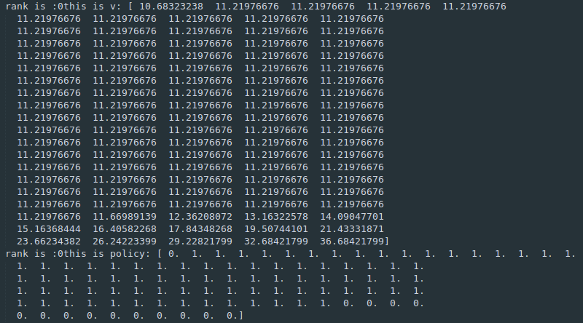
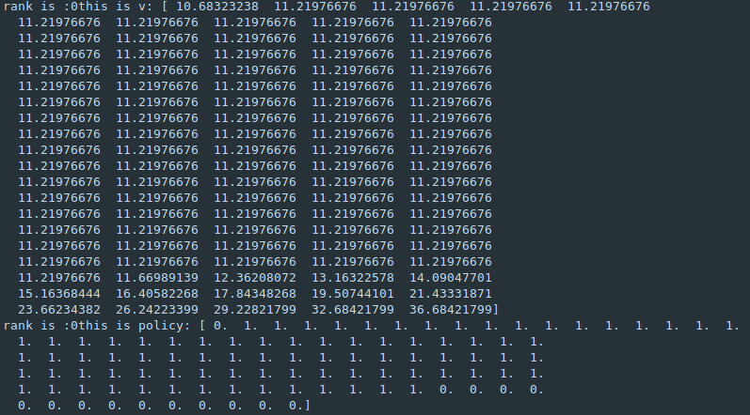
Forest Problem - 100 States

Slide 9
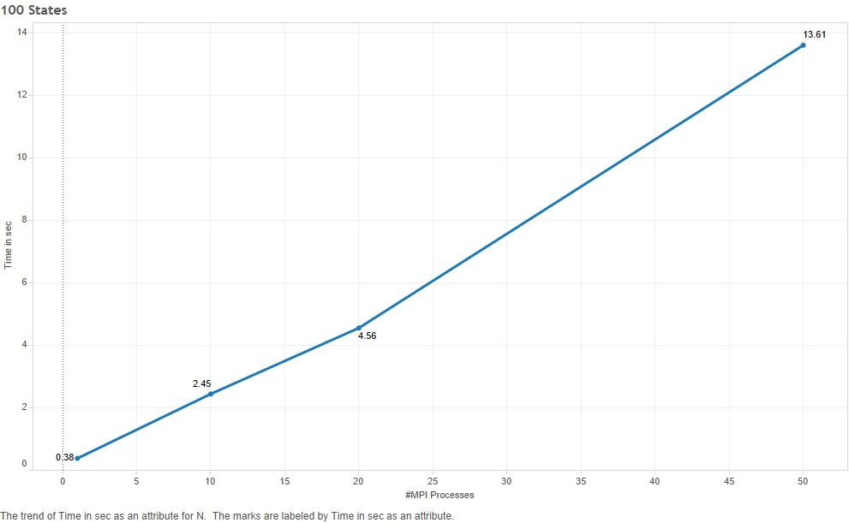
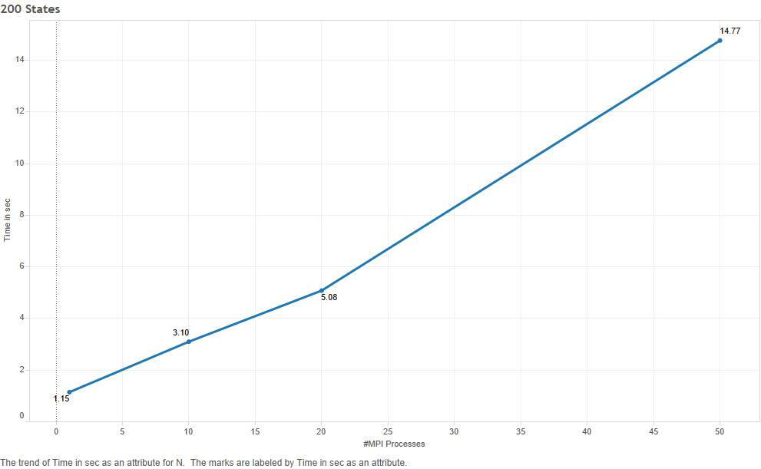
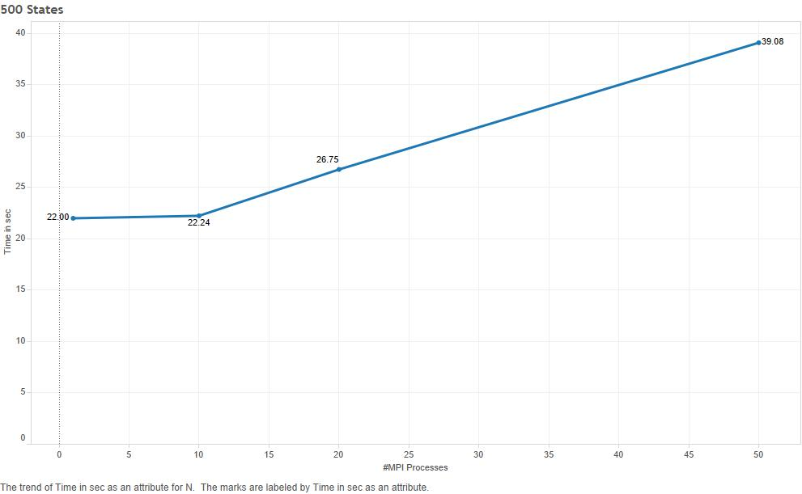
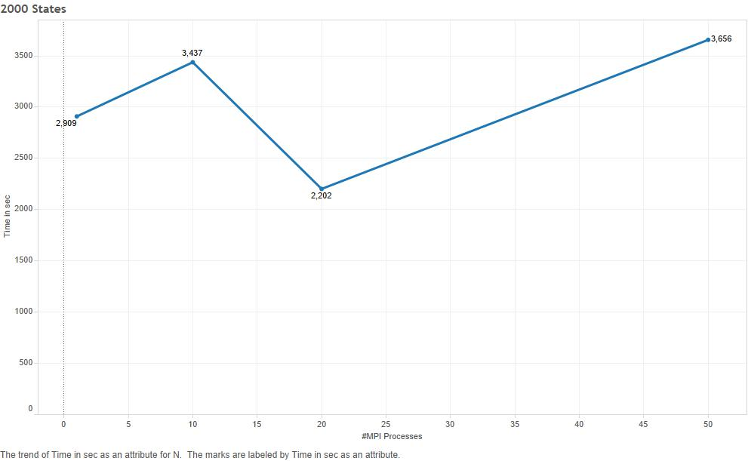
Notes:
Show the cprofile document

